Slide 2
Publish a web app with Azure Static Web Apps
Speaker Name
Title
Speaker Name
Title
Notes:
Link to published module on Learn: https://docs.microsoft.com/en-us/learn/modules/learn-pr/azure/publish-app-service-static-web-app-api/

Slide 3
Prerequisites
Familiarity with web development, knowledge of HTML, JavaScript and CSS
Node.js LTS and Git
GitHub account
Visual Studio Code

Slide 4

Learning objectives
Choose
Choose an existing web app project with either Angular, React, Svelte or Vue
Run
Run the application locally
Publish
Publish the app to Azure Static Web Apps

Slide 5

Agenda
Introduction
Exercise - Get started
Plan your Azure Static Web App
Exercise - Create an Azure Static Web App
Summary

Slide 6
Introduction

Slide 7

Scenario
Your want to publish a web app to Azure and show your student peers
Notes:
Your company is launching a shopping list web app. Through the site, customers can add, edit, view, and remove items such as food and household needs from their list.
The site and APIs need to be secure to ensure customer privacy. Your users will be distributed all over the world, and you want everyone to get great performance. You'd prefer a solution that removes as much of the infrastructure work, including building and publishing, as possible so you can concentrate on features and user experience.
You could deploy your web assets to cloud storage, create, and assign your own SSL certificate, create your API on a cloud server, establish a reverse proxy that allows your app to make calls to the API, distribute the app globally, and set up your own CI/CD process.
When you use Azure Static Web Apps, you get all of this out of the box.

Slide 8
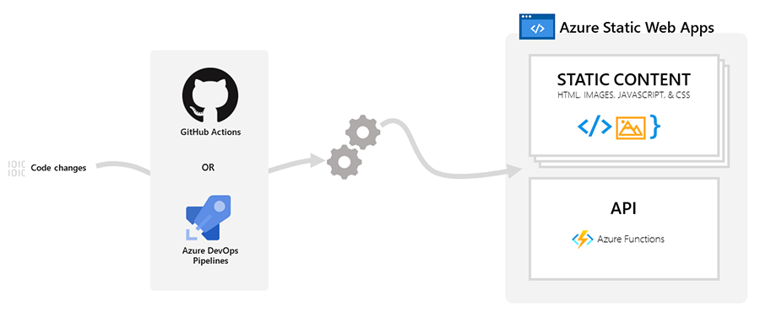
What is Azure Static Web Apps?
Azure Static Web Apps solves the hard problems all the way from your source code to global availability.
Notes:
Azure Static Web Apps solves the hard problems all the way from your source code to global availability.
While you stay focused on developing your app, Azure Static Web Apps automatically builds and hosts it from GitHub or Azure DevOps.
Static web apps are commonly built using libraries and frameworks like Angular, React, Svelte, or Vue. These apps include HTML, CSS, JavaScript, and image assets that make up the application. When using a traditional web server architecture, these files are served from a single server along side any required API endpoints.
With Azure Static Web Apps, static assets are separated from a traditional web server and are instead served from points globally distributed around the world. This distribution makes serving files much faster as files are physically closer to users. API endpoints, which are optional, are hosted using a serverless architecture, which avoids the need for a full back-end server all together.
The model for Azure Static Web Apps is that you get exactly what you need, no more, no less.
When you create an Azure Static Web Apps resource, Azure sets up a GitHub Actions or Azure DevOps workflow in the app's source code repository. The workflow monitors a branch of your choice. Every time you push commits or create pull requests into the watched branch, the workflow automatically builds and deploys your app and its API to Azure.
Azure hosts and serves your web app. Azure Functions powers back-end API functionality, which provides automatic scaling out and scaling in based on demand.

Slide 9


Optional APIs
Azure Static Web Apps is ideal for serving purely static content, but it also has great support for static web apps that need APIs behind them.
Notes:
Azure Static Web Apps is ideal for serving purely static content, but it also has great support for static web apps that need APIs behind them. So you can host your static web app with or without an API.
In this module's exercises, you'll deploy an app using your preferred web framework.
[!NOTE] You'll be deploying an app, without an API in this module. See the Next Steps section in the final unit for information about the next module, where you'll deploy an API alongside your app.

Slide 10

Key features
Globally distributed web hosting puts static content like HTML, CSS, JavaScript, and images closer to your users
Integrated API support provided by Azure Functions
First-class GitHub and Azure DevOps integration where repository changes trigger builds and deployments.
Free SSL certificates, which are automatically renewed
Unique preview URLs for previewing pull requests
Notes:
Globally distributed web hosting puts static content like HTML, CSS, JavaScript, and images closer to your users
Integrated API support provided by Azure Functions
First-class GitHub and Azure DevOps integration where repository changes trigger builds and deployments.
Free SSL certificates, which are automatically renewed
Unique preview URLs for previewing pull requests

Slide 11
What’s a Web framework?
Framework capable of producing files needed for a Web app like HTML, CSS and JavaScript files
Some frameworks are capable of handling things like data input, routing between pages and more
A subset of frameworks are known as SPAs, single page application,
examples are Angular, React, Svelte and Vue.js

Slide 12
Choose your own path
This module provides four variations of the sample application for you to choose from: Angular, React, Svelte, and Vue.
Code
? angular-app ?? The Angular client app ? react-app ?? The React client app ? svelte-app ?? The Svelte client app ? vue-app ?? The Vue client app
Notes:
This module provides four variations of the sample application for you to choose from: Angular, React, Svelte, and Vue. The power of Azure Static Web Apps is that all of these flavors "just work".
The starter code includes the four apps that you'll use.
? angular-app ?? The Angular client app ? react-app ?? The React client app ? svelte-app ?? The Svelte client app ? vue-app ?? The Vue client app

Slide 13
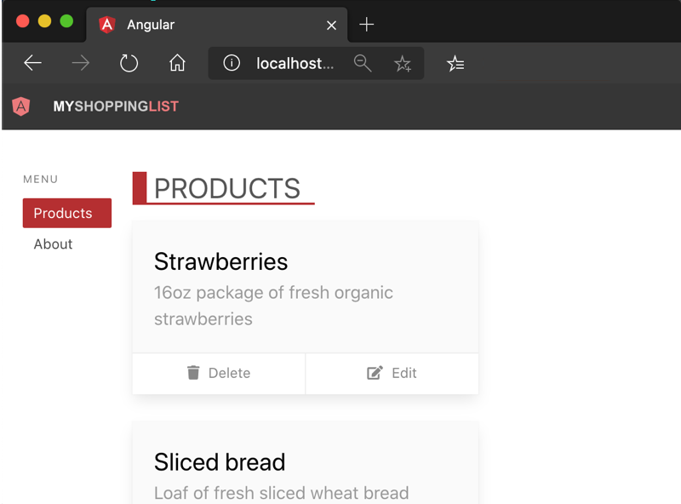
What you'll do
After you choose your client application, you'll:
Build and run your front-end application.
Automatically build and deploy your web app to Azure from a GitHub repository with GitHub Actions.
Finally, you'll explore and launch your application, as follows.
Notes:
After you choose your client application, you'll:
Build and run your front-end application.
Automatically build and deploy your web app to Azure from a GitHub repository with GitHub Actions.
Finally, you'll explore and launch your application, as follows.

Slide 14
Next steps
About now, you might be thinking you need to create the Azure resources first, but Azure Static Web Apps has your daily workflow in mind.
Notes:
About now, you might be thinking you need to create the Azure resources first, but Azure Static Web Apps has your daily workflow in mind. A more natural approach is to start with the code in GitHub first, before creating resources in Azure.

Slide 15
Exercise
Get started
Notes:
Link to published module on Learn: https://docs.microsoft.com/en-us/learn/modules/learn-pr/azure/publish-app-service-static-web-app-api/2-exercise-get-started

Slide 16
Get started
Azure Static Web Apps publishes websites to a production environment by building apps from a GitHub repository.
Create a repository
Run your app
Browse to your app
Next steps
Notes:
https://docs.microsoft.com/en-us/learn/modules/learn-pr/azure/publish-app-service-static-web-app-api/2-exercise-get-started

Slide 17
Plan your Azure Static Web App

Slide 18

Plan your Azure Static Web App
Your ultimate goal is to host your app in Azure.
App
Create Azure static app resource
creates
GitHub actions
GitHub workflow
Change -> Redeploy
creates
Azure resources for the Azure static app
Notes:
Your ultimate goal is to host your app in Azure. Azure Static Web Apps takes care of provisioning all the necessary Azure resources for you.
However, before your app can be hosted, you need something to build your app as you make changes. Those changes could be via commits or pull requests to your repository. A key feature of Azure Static Web Apps is that it sets up a GitHub Actions workflow to build and publish your application.
When you create the Azure Static Web Apps resource, it creates the GitHub Actions workflow. The workflow is triggered immediately and takes care of building and publishing your app. The workflow is also triggered every time you make a change to the watched branch in your repository.

Slide 19
Azure Static Web Apps
There are two automated aspects to deploying a web app.
1) Code change
App
GitHub actions
GitHub workflow
2) Redeploy
Azure resources for the Azure static app
Notes:
There are two automated aspects to deploying a web app. The first provisions the underlying Azure resources that make up your app. The second is a GitHub Actions workflow that builds and publishes your application.
When you publish your app to the web with Azure Static Web Apps, you're getting fast hosting of your web app and scalable APIs. You're also getting a unified build and deployment workflow provided by GitHub Actions.

Slide 20
Connect your Static Web Apps instance to GitHub
Azure Static Web Apps is designed to host applications where the source code lives on GitHub.
Location | Location example | Description | Required
App location | / | The location of the source code for your web app | Yes
App build output location | dist | The location of your app's build output, relative to your app location | No
API location | api | The location of the source code for your API | No
Notes:
Azure Static Web Apps is designed to host applications where the source code lives on GitHub. When you create a Static Web Apps instance, you'll sign in to GitHub and specify the repository containing your app's code.
You also need to specify three folder paths within your repository so your app can be automatically built and deployed:
[Table was here]
The App build output is a relative path to the build output directory of your application. For example, consider we have an app at my-app that outputs its built assets to a my-app/dist folder. In this case, you specify dist for this location.

Slide 21
From source code to static assets with GitHub Actions
Your GitHub repository contains source code, so it needs to be built before it can be published.
If you are using a framework
Notes:
Your GitHub repository contains source code, so it needs to be built before it can be published.
When you create a Static Web Apps instance, Azure creates a GitHub Actions workflow in your repository. The workflow builds your app every time you push changes or create a pull request against the branch you chose to track. This build process turns your source code into static assets, which are served by Azure. Once the build is complete, then the action deploys the assets.
The GitHub Action is added to your repository in the .github/workflows folder. You can review or modify this file as needed. The settings you enter when you create the resource are stored in the GitHub Action's file.

Slide 22
Integrated API with Azure Functions
If your app requires an API, you can implement it as an Azure Functions project in your repository.
Notes:
If your app requires an API, you can implement it as an Azure Functions project in your repository. Your API will automatically deploy and be hosted by your Static Web Apps instance. The GitHub Actions workflow that builds and deploys your app locates the API within your repo by the name of the folder you specify.
Typically, you put the API app in a folder named api or functions, but you can name it whatever you prefer.
What if you don't have an API? Don't worry. If Azure Static Web Apps can't find an API in the folder you indicate, it won't publish an API, but it will still publish your app.

Slide 23
Handle fallback routes
You see a 404 error when you refresh the page because the browser sends a request to the hosting platform to serve /products.
JSON
{ "navigationFallback": { "rewrite": "index.html", "exclude": ["/images/*.{png,jpg,gif,ico}", "/*.{css,scss,js}"] } }
Notes:
You see a 404 error when you refresh the page because the browser sends a request to the hosting platform to serve /products. There's no page on the server named products to serve. Fortunately, it's easy to resolve this by creating a fallback route. A fallback route is a route that matches all unmatched page requests to the server.
Azure Static Web Apps supports custom routing rules defined in an optional staticwebapp.config.json file located in the app's build output folder.
You can configure your app to use rules that implement a fallback route as shown in the following example that uses a path wildcard with file filter:
{ "navigationFallback": { "rewrite": "index.html", "exclude": ["/images/*.{png,jpg,gif,ico}", "/*.{css,scss,js}"] } }
This rule tells Azure Static Web Apps to serve index.html when a request for an resource is not found, excluding the images and CSS files shown in the exclude expression.

Slide 24
Route file location
Azure Static Web Apps expects your staticwebapp.config.json file to be in the output_location by default.
Notes:
Azure Static Web Apps expects your staticwebapp.config.json file to be in the output_location by default. If your build process copies your staticwebapp.config.json file to the output_location, then there is nothing else you need to do.
The staticwebapp.config.json file for your application is located in the folder angular-app/src/assets
The staticwebapp.config.json file is located in the folder react-app/public
The staticwebapp.config.json file is located in the folder svelte-app/public
The staticwebapp.config.json file is located in the folder vue-app/public

Slide 25
Next steps
So what do you need so you can publish your web app to Azure Static Web Apps? All you need is your app in your GitHub repository.
Notes:
So what do you need so you can publish your web app to Azure Static Web Apps? All you need is your app in your GitHub repository.

Slide 26
Knowledge check

Slide 27
Question 1
What section of the _staticwebapp.config.json_ file would you put the fallback route?
routes
responseOverrides
navigationFallback
Notes:
Explanation: The `navigationFallback` section is where you define a server-side fallback route to serve the appropriate HTML page (which is generally the index.html for your client-side app).

Slide 28
Question 1
What section of the _staticwebapp.config.json_ file would you put the fallback route?
routes
responseOverrides
navigationFallback
Notes:
Explanation: The `navigationFallback` section is where you define a server-side fallback route to serve the appropriate HTML page (which is generally the index.html for your client-side app).

Slide 29
Exercise
Create an Azure Static Web App
Notes:
Link to published module on Learn: https://docs.microsoft.com/en-us/learn/modules/learn-pr/azure/publish-app-service-static-web-app-api/4-exercise-static-web-apps

Slide 30
Create an Azure Static Web App
In this exercise, you'll create an Azure Static Web Apps instance including a GitHub Action that will automatically build and publish your application.
Create a static web app
Install the Azure Static Web Apps extension for Visual Studio Code
Sign in to Azure in Visual Studio Code
Select Your Subscription
Create a static web app
Notes:
https://docs.microsoft.com/en-us/learn/modules/learn-pr/azure/publish-app-service-static-web-app-api/4-exercise-static-web-apps

Slide 31
Summary

Slide 32
Summary
You needed to build a shopping list web app that is secure and offers good performance for a globally distributed customer base.
Performance and Scale: Your web assets are globally distributed, putting them closer to your users, to minimize latency and business logic is run on Azure Functions that scale automatically to meet demand.
Productivity: You get an automated build pipeline with CI/CD while.
Security: The web app is secured with an SSL certificate.
Notes:
You needed to build a shopping list web app that is secure and offers good performance for a globally distributed customer base. Your primary concerns were to limit the amount of infrastructure work and focusing on the business features and user experience.
Azure Static Web Apps are a great fit for this scenario:
Performance and Scale: Your web assets are globally distributed, putting them closer to your users, to minimize latency and business logic is run on Azure Functions that scale automatically to meet demand.
Productivity: You get an automated build pipeline with CI/CD while.
Security: The web app is secured with an SSL certificate.
Without Azure Static Web Apps, you could deploy your web assets to cloud storage, create, and assign your own SSL certificate, create your API, establish a reverse proxy that allows your app to make calls to the API, distribute the app globally, and set up your own CI/CD process.
Azure Static Web Apps gives you all of these benefits. This lets you spend your time on building new features and optimizing the user experience rather than creating and maintaining site infrastructure.

Slide 33
Additional resources
Here are several resources where you can learn more about Azure Static Web Apps, Visual Studio Code, and other concepts covered in this module.
Learn how to Publish an API to Azure Static Web Apps
Learn how to Authenticate users with Azure Static Web Apps
Azure Static Web Apps on Microsoft Docs
Use Angular, React, and Vue in Visual Studio Code
Notes:
Here are several resources where you can learn more about Azure Static Web Apps, Visual Studio Code, and other concepts covered in this module.
Learn how to Publish an API to Azure Static Web Apps
Learn how to Authenticate users with Azure Static Web Apps
Azure Static Web Apps on Microsoft Docs
Use Angular, React, and Vue in Visual Studio Code

